Slide 1

CHAPTER 1
SPEAKING
MATHEMATICALLY
Copyright © Cengage Learning. All rights reserved.

Slide 2
SECTION 1.3
The Language of
Relations and Functions
Copyright © Cengage Learning. All rights reserved.

Slide 3
The Language of Relations and Functions
The objects of mathematics may be related in various ways.
A set A may be said to be related to a set B if A is a subset of B, or if A is not a subset of B, or if A and B have at least one element in common.
A number x may be said to be related to a number y if
x < y, or if x is a factor of y, or if x² + y² = 1.
Let A = {0, 1, 2} and B = {1, 2, 3} and let us say that an element x in A is related to an element y in B if, and only if, x is less than y.

Slide 4
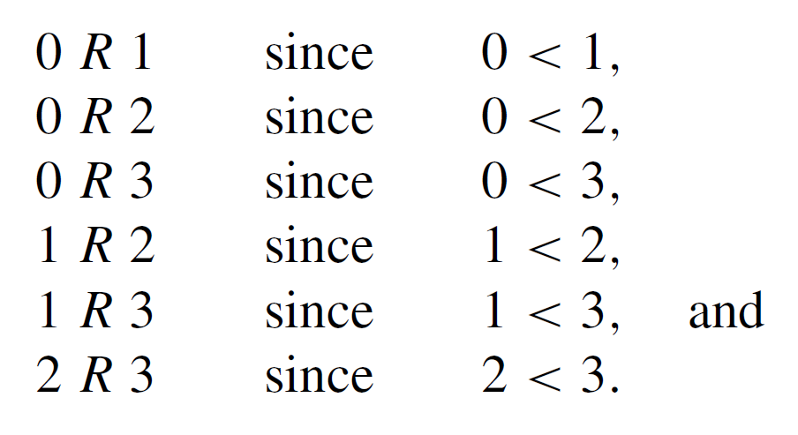

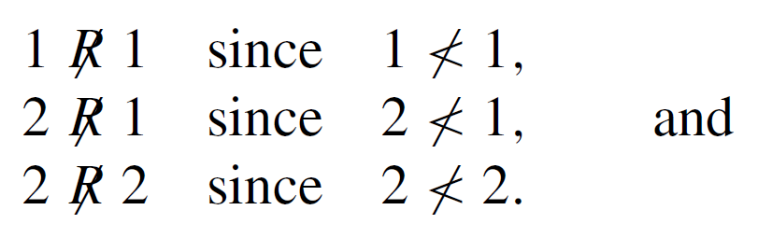
The Language of Relations and Functions
Let us use the notation x R y as a shorthand for the sentence “x is related to y.” Then
On the other hand, if the notation represents the sentence “x is not related to y,” then

Slide 5
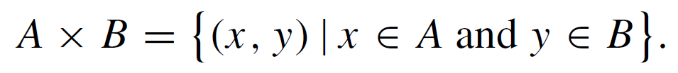
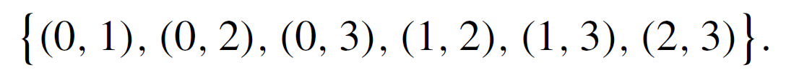
The Language of Relations and Functions
The Cartesian product of A and B, A × B, consists of all ordered pairs whose first element is in A and whose second element is in B:
In this case,
The elements of some ordered pairs in A × B are related, whereas the elements of other ordered pairs are not. Consider the set of all ordered pairs in A × B whose elements are related

Slide 6
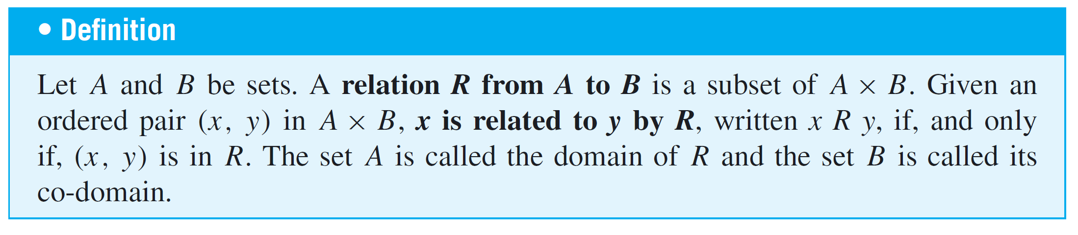
The Language of Relations and Functions
Observe that knowing which ordered pairs lie in this set is equivalent to knowing which elements are related to which.
The relation itself can therefore be thought of as the totality of ordered pairs whose elements are related by the given condition.

Slide 7

The Language of Relations and Functions
The notation for a relation R may be written symbolically as follows:
x R y means that (x, y ) ∈ R.
The notation x y means that x is not related to y by R:
x y means that (x, y ) ∉ R.

Slide 8
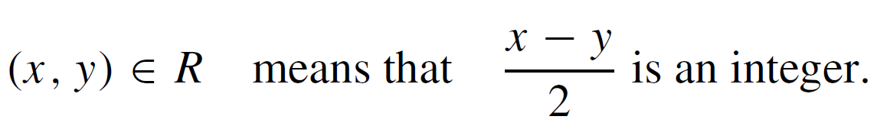
Example 1 – A Relation as a Subset
Let A = {1, 2} and B = {1, 2, 3} and define a relation R from A to B as follows: Given any (x, y) ∈ A × B,
a. State explicitly which ordered pairs are in A × B and
which are in R.
b. Is 1 R 3? Is 2 R 3? Is 2 R 2?
c. What are the domain and co-domain of R?

Slide 9
Example 1 – Solution
a. A × B = {(1, 1), (1, 2), (1, 3), (2, 1), (2, 2), (2, 3)}. To
determine explicitly the composition of R, examine each
ordered pair in A × B to see whether its elements satisfy
the defining condition for R.

Slide 10

Example 1 – Solution
cont’d
Thus
b.
c.

Slide 11
Arrow Diagram of a Relation

Slide 12
Arrow Diagram of a Relation
Suppose R is a relation from a set A to a set B. The arrow diagram for R is obtained as follows:
Represent the elements of A as points in one region and the elements of B as points in another region.
For each x in A and y in B, draw an arrow from x to y if,
and only if, x is related to y by R. Symbolically:
Draw an arrow from x to y
if, and only if, x R y
if, and only if, (x, y) ∈ R.

Slide 13
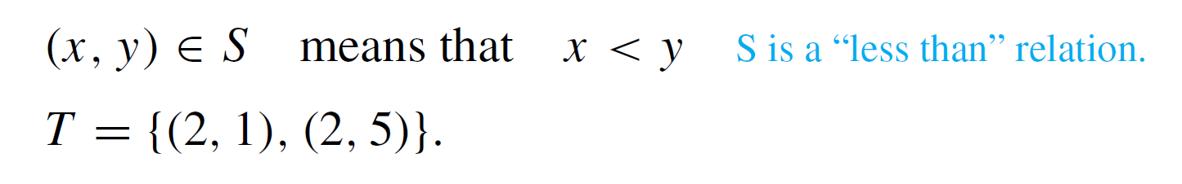
Example 3 – Arrow Diagrams of Relations
Let A = {1, 2, 3} and B = {1, 3, 5} and define relations S and T from A to B as follows:
For all (x, y ) ∈ A × B,
Draw arrow diagrams for S and T.

Slide 14
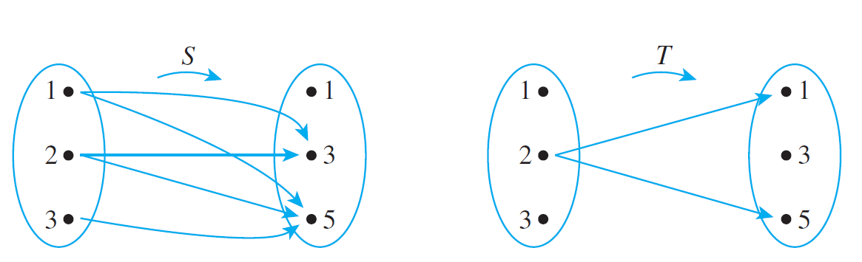
Example 3 – Solution
These example relations illustrate that it is possible to have several arrows coming out of the same element of A pointing in different directions.
Also, it is quite possible to have an element of A that does not have an arrow coming out of it.

Slide 15
Functions

Slide 16
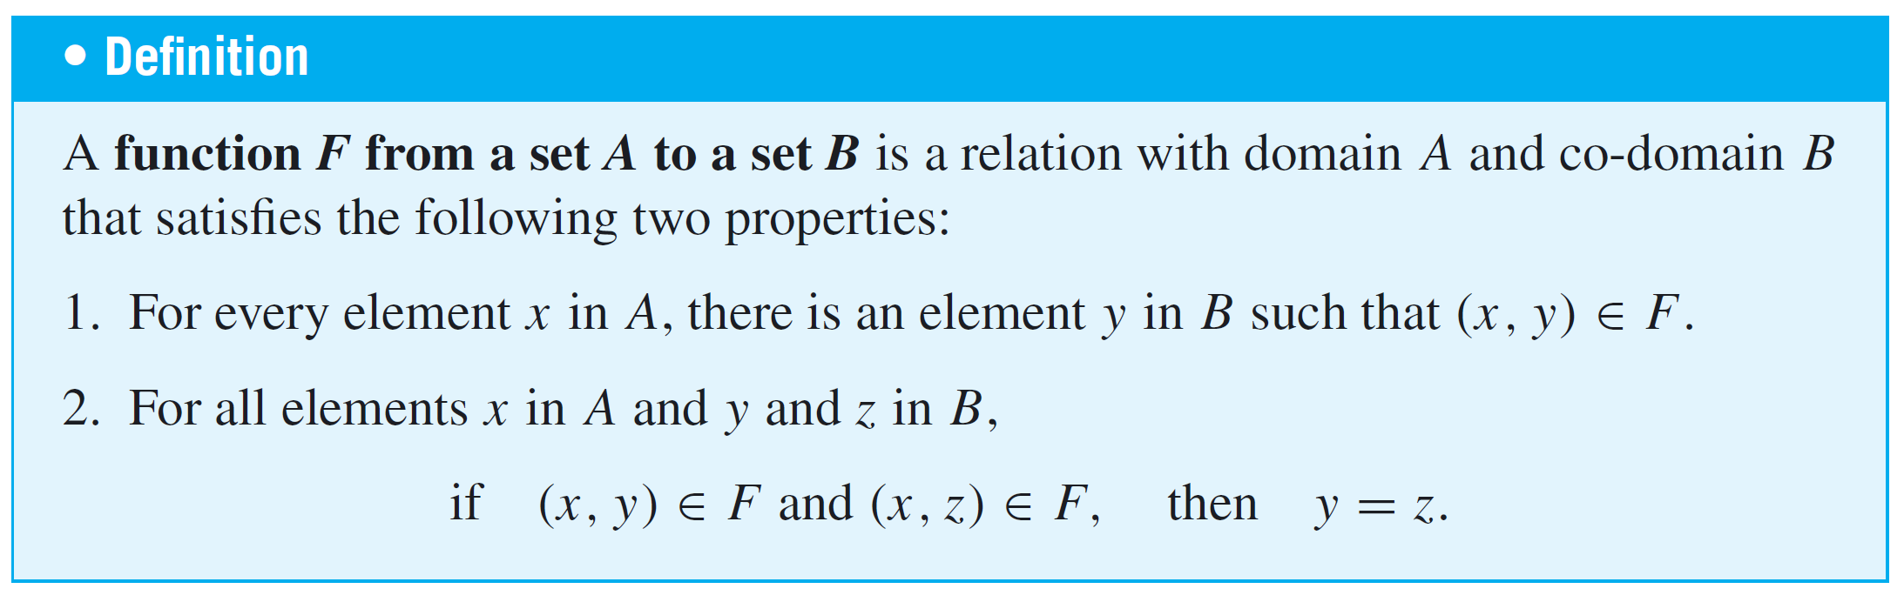
Functions

Slide 17
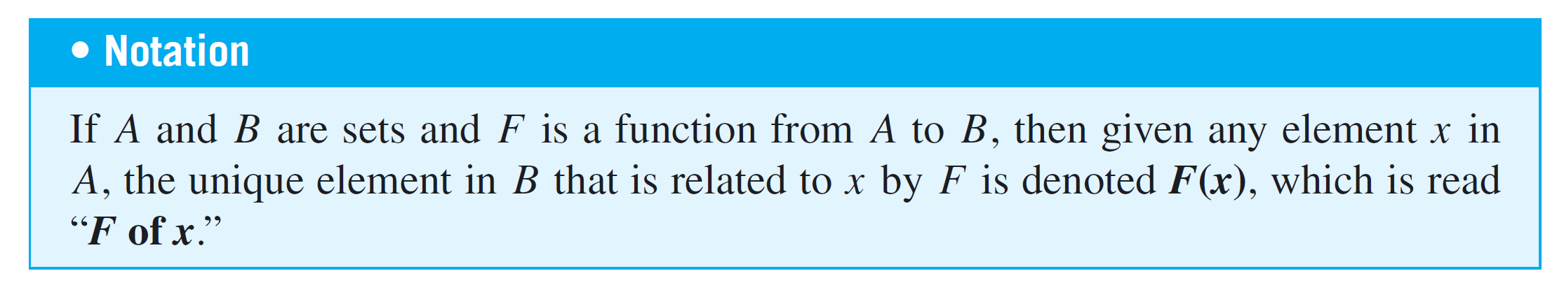
Functions
Properties (1) and (2) can be stated less formally as follows: A relation F from A to B is a function if, and only if:
1. Every element of A is the first element of an ordered pair
of F.
2. No two distinct ordered pairs in F have the same first
element.

Slide 18
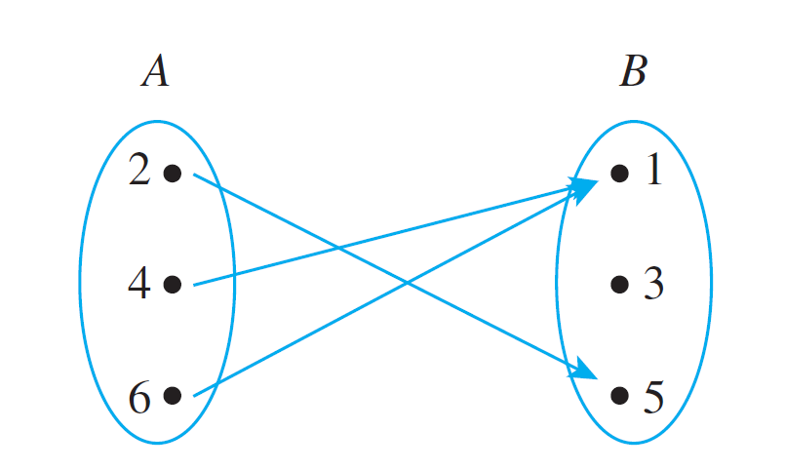
Example 4 – Functions and Relations on Finite Sets
Let A = {2, 4, 6} and B = {1, 3, 5}. Which of the relations R, S, and T defined below are functions from A to B?
a. R = {(2, 5), (4, 1), (4, 3), (6, 5)}
b. For all (x, y ) ∈ A × B, (x, y ) ∈ S means that y = x + 1.
c. T is defined by the arrow diagram

Slide 19
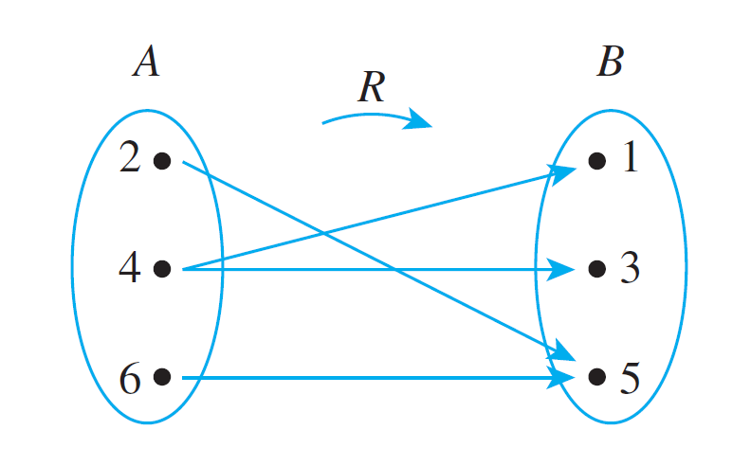
Example 4(a) – Solution
R is not a function because it does not satisfy property (2). The ordered pairs (4, 1) and (4, 3) have the same first element but different second elements.
You can see this graphically if you draw the arrow diagram for R. There are two arrows coming out of 4: One points to 1 and the other points to 3.

Slide 20
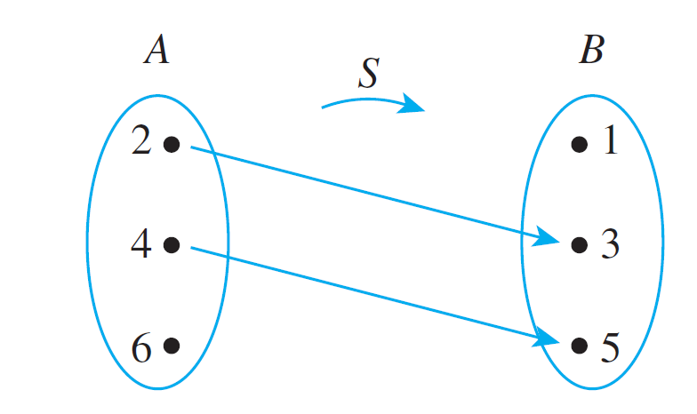
Example 4(b) – Solution
cont’d
S is not a function because it does not satisfy property (1). It is not true that every element of A is the first element of an ordered pair in S.
For example, 6 ∈ A but there is no y in B such that
y = 6 + 1 = 7. You can also see this graphically by drawing the arrow diagram for S.

Slide 21
Example 4(c) – Solution
cont’d
T is a function: Each element in {2, 4, 6} is related to some element in {1, 3, 5} and no element in {2, 4, 6} is related to more than one element in {1, 3, 5}.
When these properties are stated in terms of the arrow diagram, they become (1) there is an arrow coming out of each element of the domain, and (2) no element of the domain has more than one arrow coming out of it.
So you can write T (2) = 5, T (4) = 1, and T (6) = 1.

Slide 22
Function Machines

Slide 23
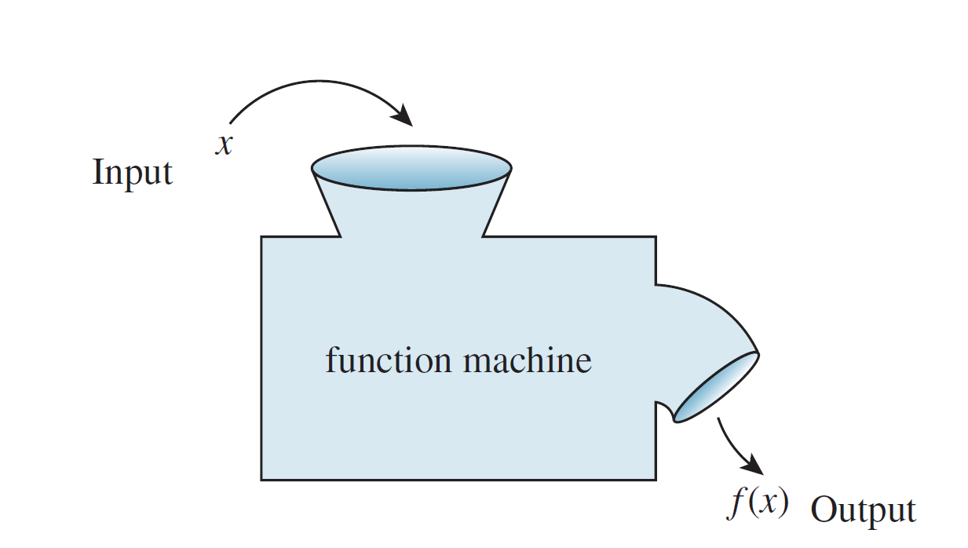
Function Machines
Another useful way to think of a function is as a machine. Suppose f is a function from X to Y and an input x of X is given.
Imagine f to be a machine that processes x in a certain way to produce the output f (x). This is illustrated in Figure 1.3.1
Figure 1.3.1

Slide 24
Example 6 – Functions Defined by Formulas
The squaring function f from R to R is defined by the formula f (x) = x² for all real numbers x.
This means that no matter what real number input is substituted for x, the output of f will be the square of that number.
This idea can be represented by writing f ( ) =  ². In other words, f sends each real number x to x², or, symbolically,
f : x → x². Note that the variable x is a dummy variable; any other symbol could replace it, as long as the replacement is made everywhere the x appears.

Slide 25
Example 6 – Functions Defined by Formulas
cont’d
The successor function g from Z to Z is defined by the formula g (n) = n + 1. Thus, no matter what integer is substituted for n, the output of g will be that number plus one: g ( ) =  + 1.
In other words, g sends each integer n to n + 1, or, symbolically, g : n → n + 1.
An example of a constant function is the function h from Q to Z defined by the formula h (r) = 2 for all rational numbers r.

Slide 26
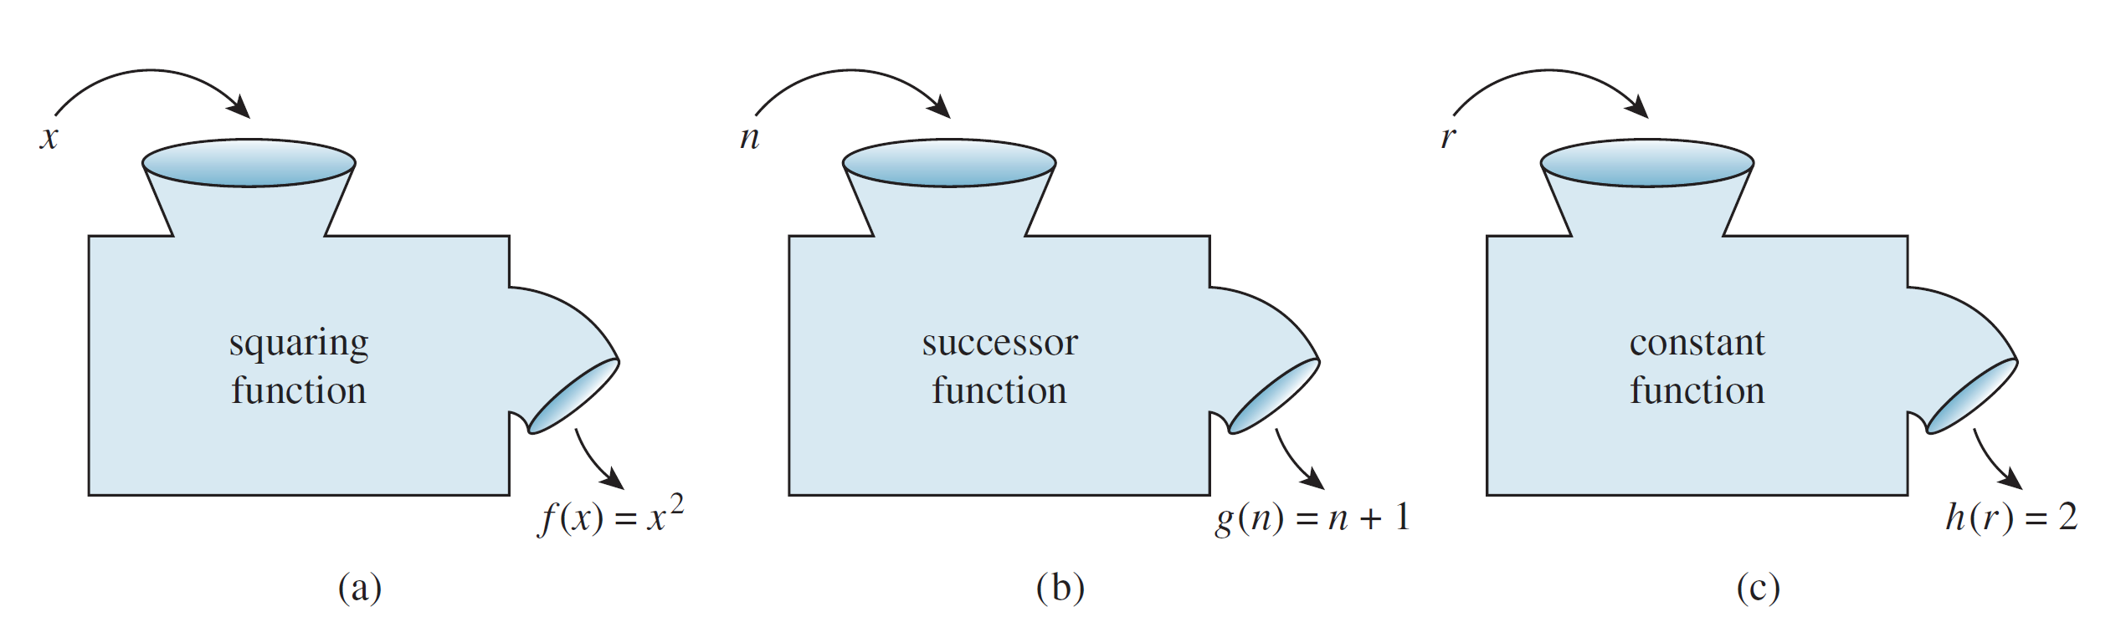
Example 6 – Functions Defined by Formulas
cont’d
This function sends each rational number r to 2. In other words, no matter what the input, the output is always
2: h( ) = 2 or h : r → 2.
The functions f, g, and h are represented by the function machines in Figure 1.3.2.
Figure 1.3.2

Slide 27
Function Machines
A function is an entity in its own right. It can be thought of as a certain relationship between sets or as an input/output machine that operates according to a certain rule.
This is the reason why a function is generally denoted by a single symbol or string of symbols, such as f, G, of log, or sin.
A relation is a subset of a Cartesian product and a function is a special kind of relation.

Slide 28
Function Machines
Specifically, if f and g are functions from a set A to a set B, then
f = {(x, y) ∈ A × B | y = f (x)}
and
g = {(x, y) ∈ A × B | y = g (x)}.
It follows that
f equals g, written f = g,
if, and only if, f (x) = g (x) for all x in A.

Slide 29
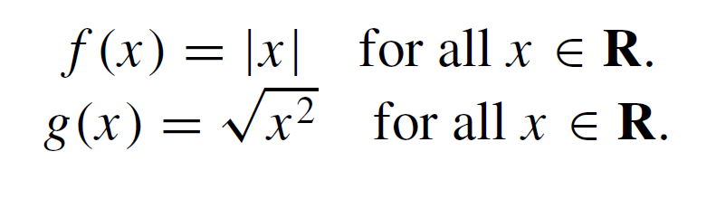
Example 7 – Equality of Functions
Define f : R → R and g: R → R by the following formulas:
Does f = g?
Solution:
Yes. Because the absolute value of any real number equals the square root of its square,

